Slide 1


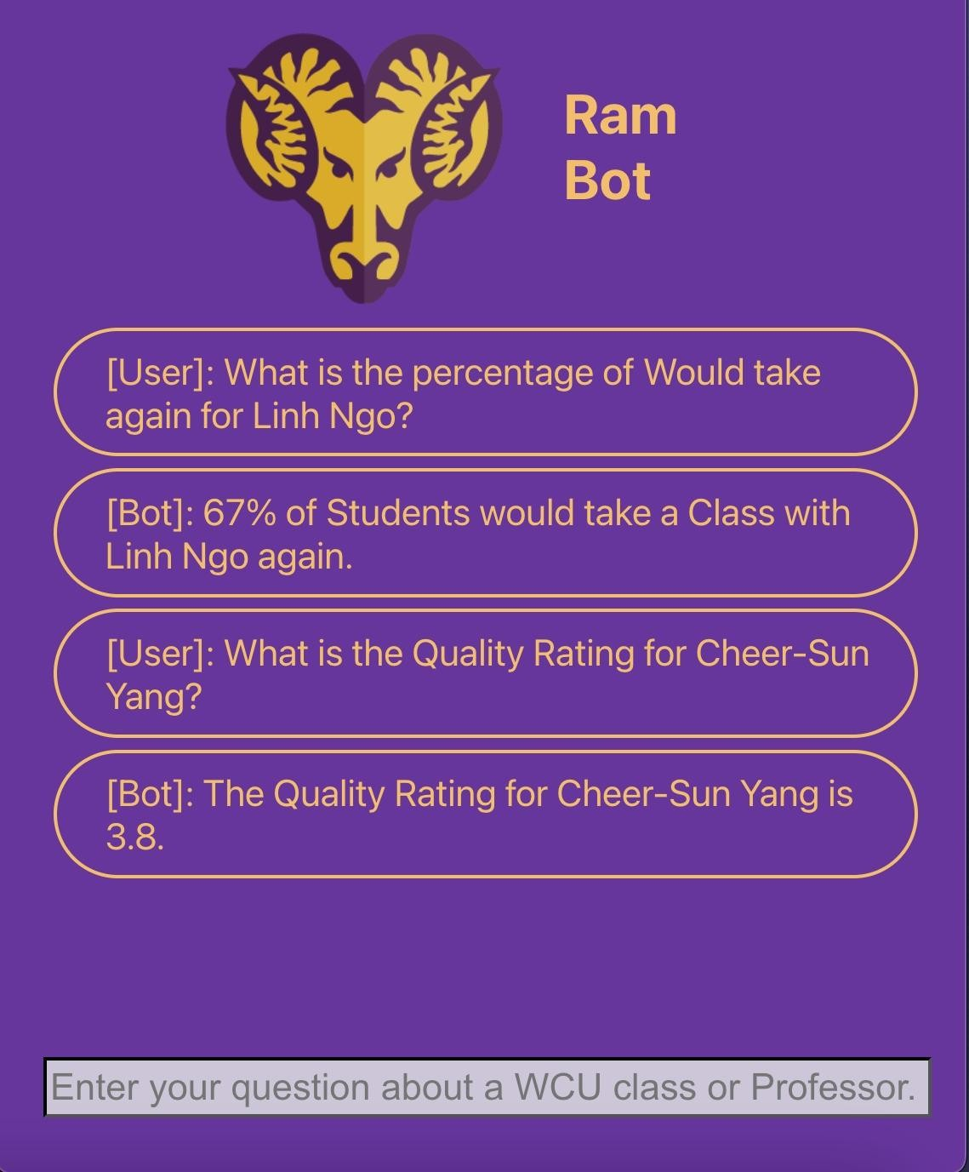




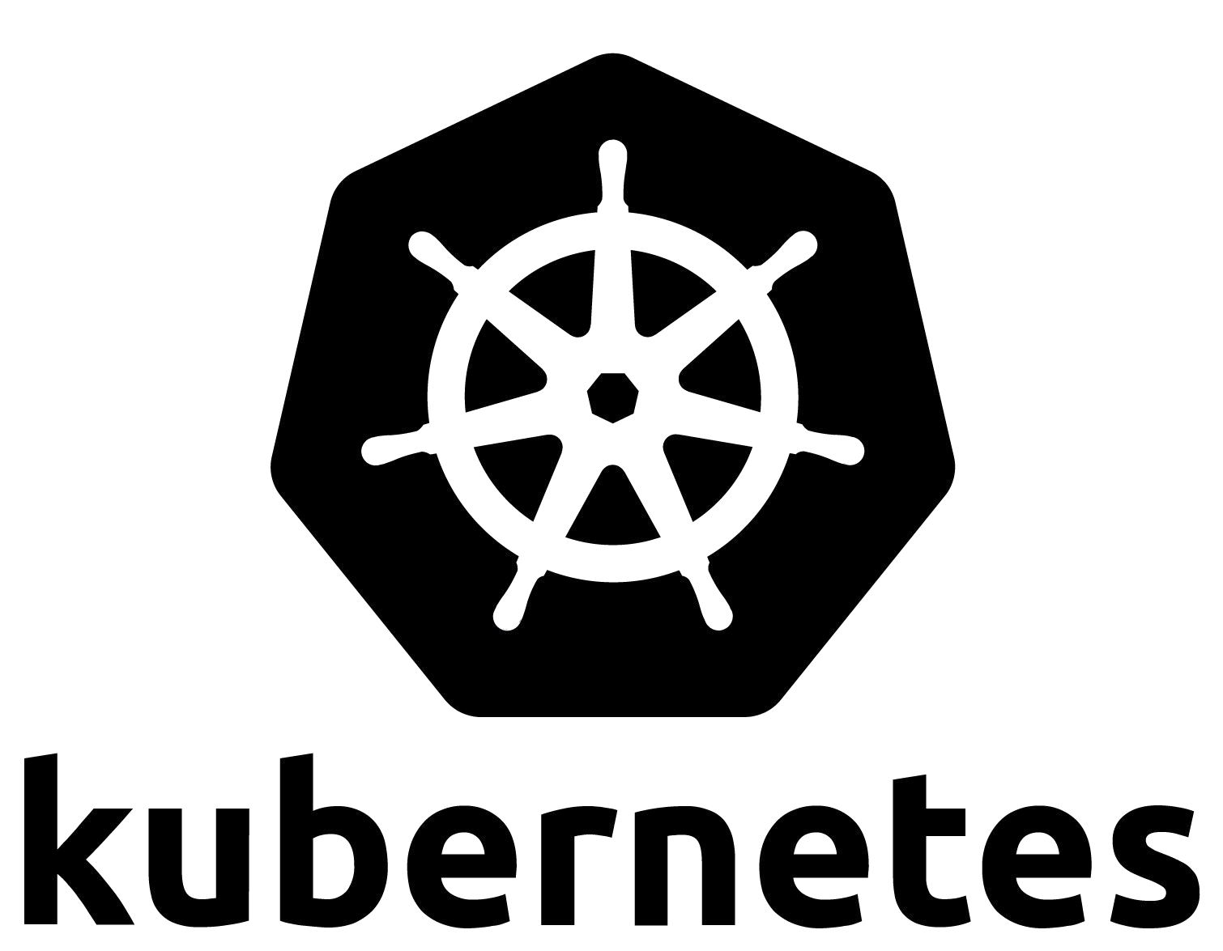

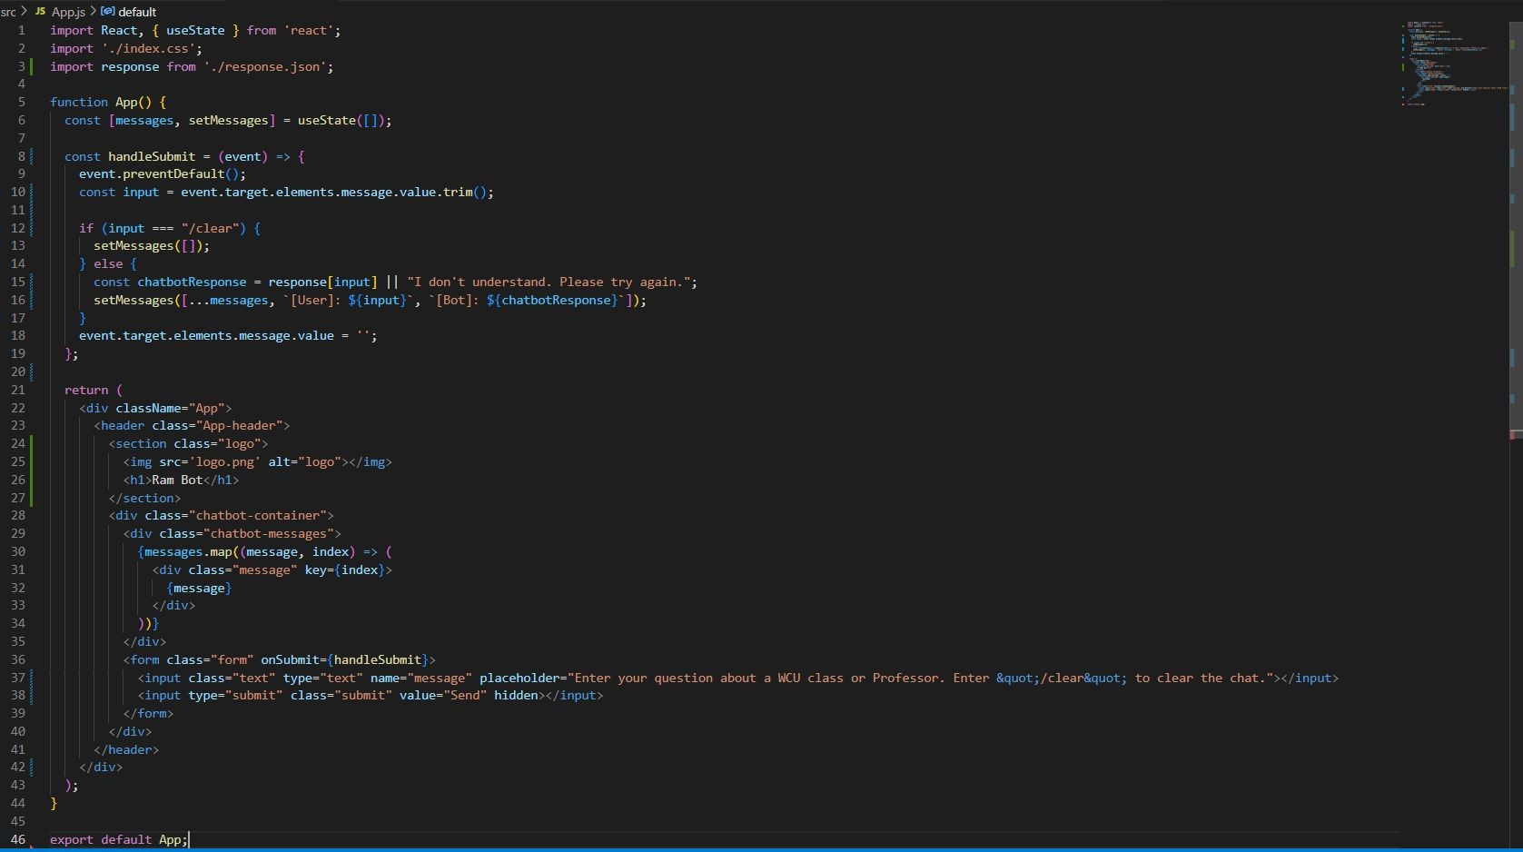




https://github.com/kanedeiley/CloudMen/tree/main
Developers: Ridha Al-Hamadani, R.Kane Deiley, Peter McClelland, Calvin Miner, Daniel Muth
GitHub:
Motivation
COMPONENTS:
RamBot User Interface:
Gets Professor data from Rate My Professor
Posts to MySQL Database Pod
Uses Selenium, BS4 & SQLAlchemy Libs
WebScraper
POST
Stores Rate My Professor Data in Pod
Hosts MySQL Server on the Pod
Database
GET
Pod can Query SQL for specific prompts
Natural Language Processing w/ Rasa
Receives and Responds to Input
Chatbot
TCP
Web UI
West Chester Themed Color Scheme
Receives Responses via Rasa’s API Endpoints
Cloud Deployment:
App.js:
-Users can submit messages, and the chatbot provides responses based on predefined rules or displays an error message if it doesn't understand the input
Database Schema:
Stores code on Github
Jenkins monitors for changes within Github
Jenkins builds docker images using Github branches
Implements Kubernetes to deploy Component’s docker images to server clusters and manages containers to ensure smooth services

